Slide 1

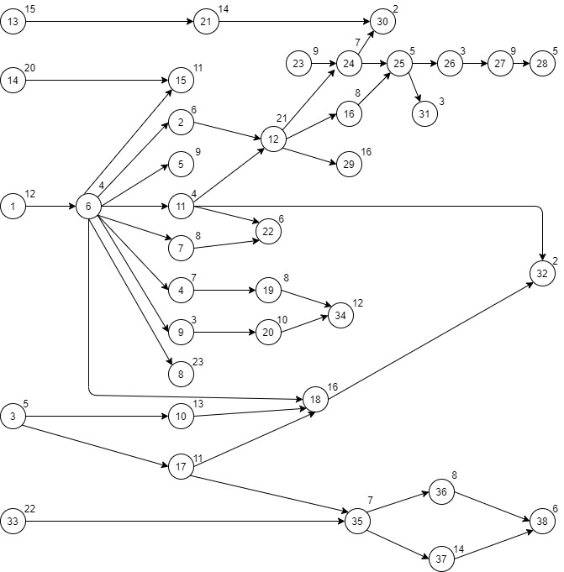
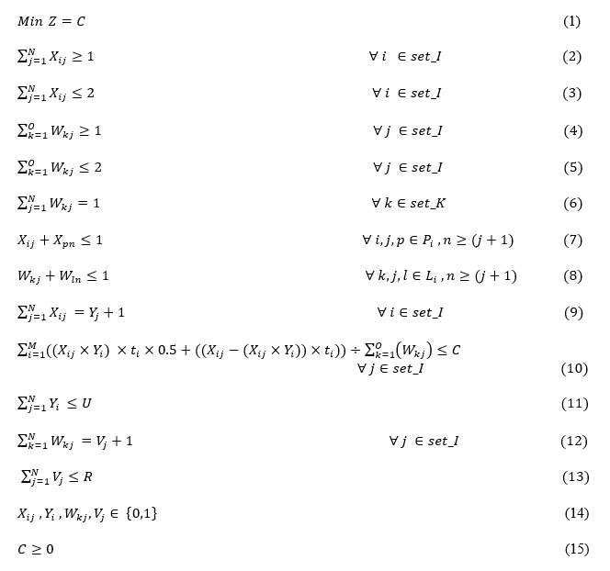
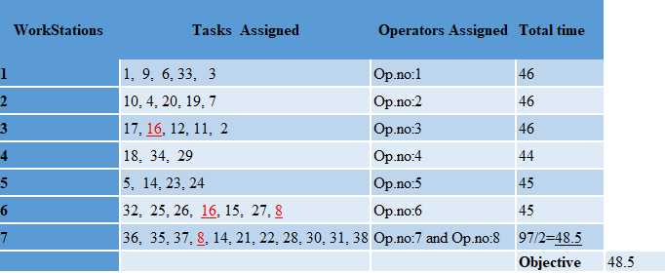
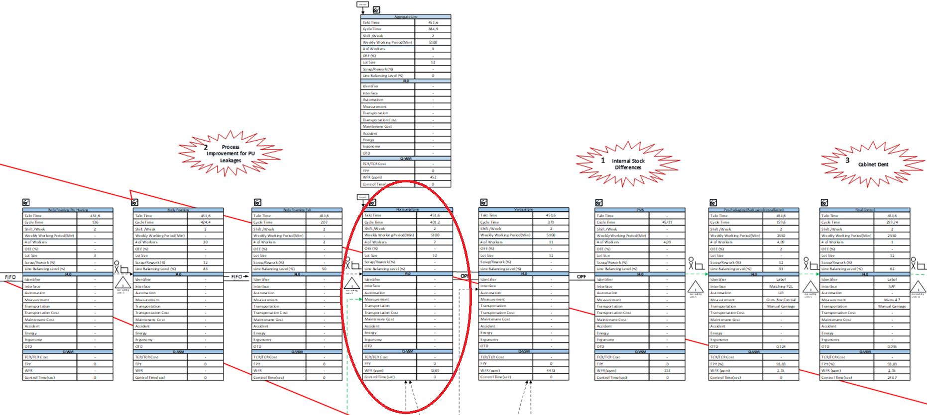
ASSEMBLY LINE BALANCING
PROF. ALEV TASKIN GUMUS
Industrial Engineering
Department
Bachelor Thesis/Project
15061029 – Busra Karaali
15061050 - Ilknur Sezen
15061069 - Mustafa Kurtoglu
ABSTRACT
Assembly lines are special production flow-line systems that are of great importance in the industrial production of high quantity products. For decades, line balancing has attracted the attention of researchers trying to find solutions to its real world applications. While tremendous work has been done in this field, there is still a gap between research and real problems. After evaluating over 100 articles, this study provides a new non-linear mixed integer mathematical programming approach to solve line balancing problem that has been provided by one of the leading companies in manufacturing sector particularly at home appliances. Applying model to given data, which is a SALBP-2 in this case, demonstrates the gains of the parallel line assignment and multi-manned workstation approach in line balancing studies. After that, difficulties with Mathematical Programming Based Approaches are discussed and a framework is proposed for future studies which contains suggestion of using Genetic Algorithms from Meta-Heuristics Approach.
.
The Precedence Diagramming Method, with its activity-on-node network and additional precedence relationships, offers a simpler and increasingly adaptable system way to deal with demonstrating complex and large tasks.
METHODOLOGY
In this study, the following steps are followed as methodology steps. In the framework of this methodology, firstly the value flow mapping(VSM) technique is used to see the whole production and stock points. Afterwards, Precedence Diagram is used to map the precedential relationships of the tasks in the line.
Value Stream Mapping
Precedence Diagram
Linear Mixed Integer Programming
Non-Linear Mixed Integer Programming
Figure 3: Precedence Diagram
Problem is formulated as a mixed-integer linear programming (MILP) model with the main objective of total completion times as given below:
Figure 1: Methodology Steps
After precedence Diagram with the inputs on the hand, the mixed integer linear programming model is structured. This linear model lacked freedom and flexibility that was required, it limited possible outcomes so it was not a good fit. Furthermore, to create a more advanced and realistic model and to give more freedom so non-linear constraints can be added, the mixed integer non-linear programming model is presented.
Figure 4: Mathematical Model
APPLICATION
Subject of the study is one of the world's leading companies in the sector and the one of the largest home appliances manufacturer in Europe. The company’s high quality level plant is analyzed in this study. The problem addressed in this research is the single-model assembly line balancing problem of type-II Each model has its own set of precedence relationships, but it is possible to combine all the relationships into one precedence diagram with various number of tasks. Each task has a processing time that may vary between models.
.
CONCLUSION
The mathematical model is solved in python programming language. Table-1 below shows which tasks and which operators are assigned to which station. Parallel assigned tasks are marked in red color. As a result of this study, a new non-linear mixed integer mathematical programming has been introduced to the literature for the solution of SALBP-2 by clearly demonstrating the gains of the parallel line assignment and multi-manned workstation approach in line balancing studies.
Figure 2: VSM
Table 1 : Results-1
In this study, the value stream mapping method was used to see the whole material and information flow from start to finish and the relationship between the information flow and the material flow
Significant gains have been shown in terms of efficient use of production time and minimization of idle times. In the following studies, this model can be improved by transforming it to a Genetic Algorithm from Meta-Heuristics Approach to use it in even more complicated, wide-ranging industry application.

